Slide 1
Green Ammonia Transportation and Cracking Optimization Model Setup and Flow
5/29 Week

Slide 2
Model requirement: decide transportation flow of ammonia from production site to end consumption
User Inputs:
Production Site
Consumption Site(s)
Model outputs:
Network flow of transportation
Optimal deployment of cracker technology

Slide 3
*Don’t have H₂ fuel cell due to short term storage focus

Slide 4
Model requirement 2: decide operations of plants on hourly timescale to meet production demands
Battery storage
Charge
Total charge
Discharge
Hydrogen storage
Store
No flow
Deploy
Electroyzer
Produce H₂
Don’t produce H₂
ASU capacity
Produce N₂
Ammonia plant capacity
Produce NH₃

Slide 5
Model inputs
RE data
Capacity factors of wind and solar
Input sheet
Various technical parameters for system setup (can show the sheet)

Slide 6
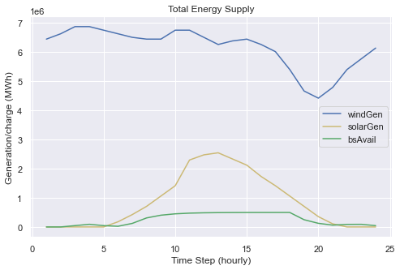
Dummy data run through of model: Energy Generation

Slide 7
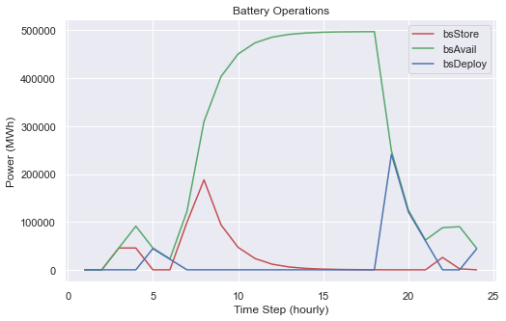
Battery Operations: store when high RE on islanded grid, discharge later in the day

Slide 8
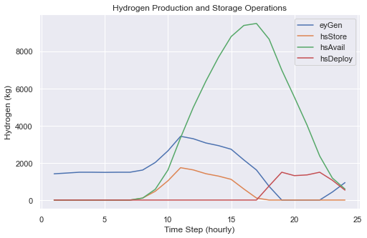
Hydrogen Production and storage: store with high RE and then deploy when solar drops off

Slide 9
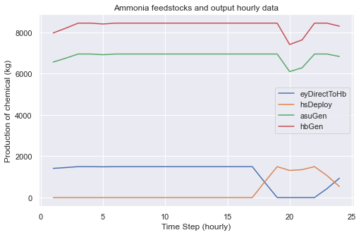
Ammonia and ASU production relatively constant with H2 direct from EY, then drops off w/ REs

Slide 10
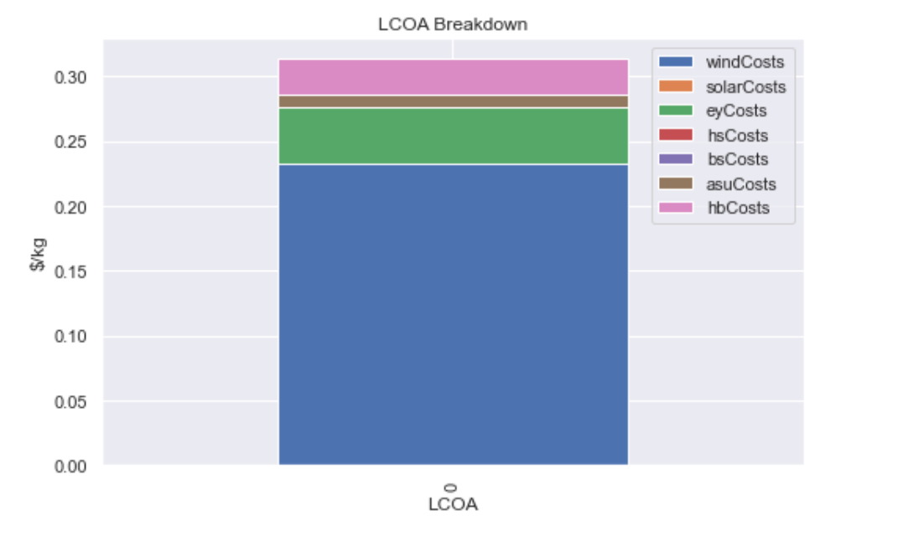
What the final outcome will look like (will develop it so its more detailed-split OPEX and CAPEX for each tech)

Slide 11
Next Steps
Clarify plant structure looks correct and pricing mechanisms are reflective
Run robust sensitivity tests on model for validity
Gather data and conduct first initial runs
Develop work on the transportation/distribution side

